Slide 1
Bioinformatics
Lecturers:
Jonathan Warrell
Prashant Emani
Slides designed by: Prashant Emani, Jonathan Warrell, Declan Clarke
Date: June 11th, 2020

Slide 2
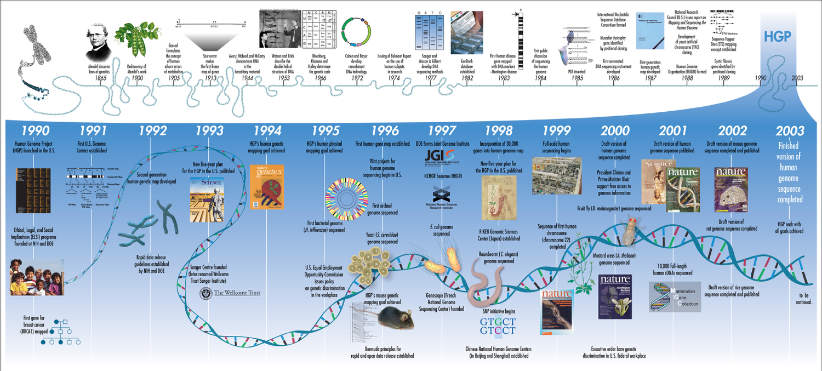
Human Genome Project
National Human Genome Research Institute (NHGRI) from Bethesda, MD, USA [CC BY 2.0 (https://creativecommons.org/licenses/by/2.0)]; Credit: Darryl Leja, NHGRI.

Slide 3
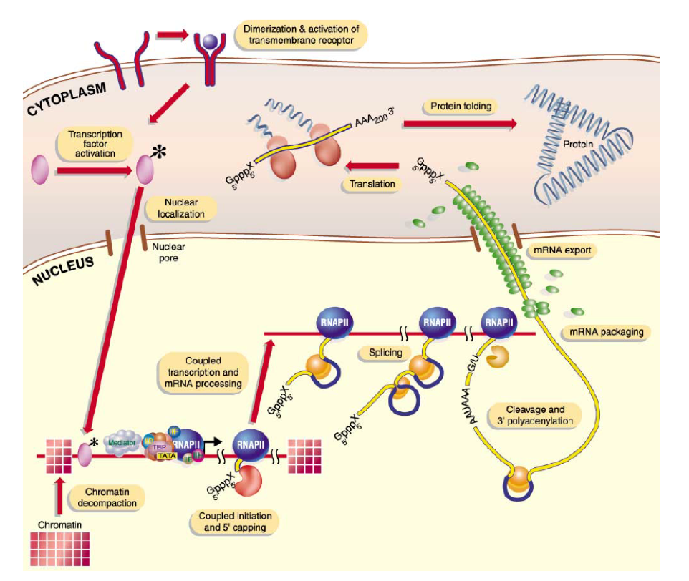
From mutations to function: Multiple steps leading from genetic variation to cellular function
Orphanides and Reinberg 2002, Cell 108, P. 439-451

Slide 4
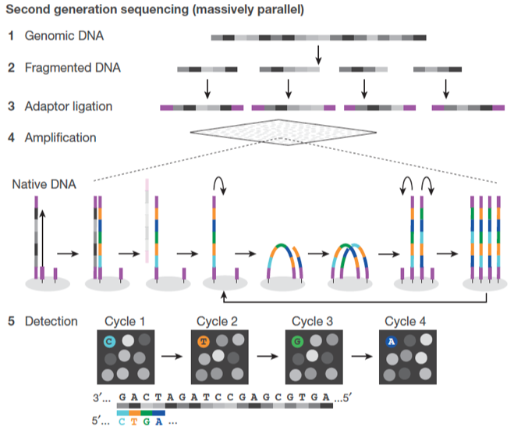
Biological Assays: Probing the various levels of cellular function
Genetic Assays:
Whole Genome/Exome Sequencing:
Entire genome/exome sequenced
Next-gen sequencing: DNA fragmented, adaptors added, amplified
Detected using fluorescence-based methods
Large sections of individual organism genomes can be sequenced
DNA Microarray Sequencing:
Fragments hybridized to arrays of specific probes with mutations at sites polymorphic in a subset of human populations
Results: mutation “hits”
Shendure et al. 2017, Nat. Rev. 550, Pgs. 345-353

Slide 5
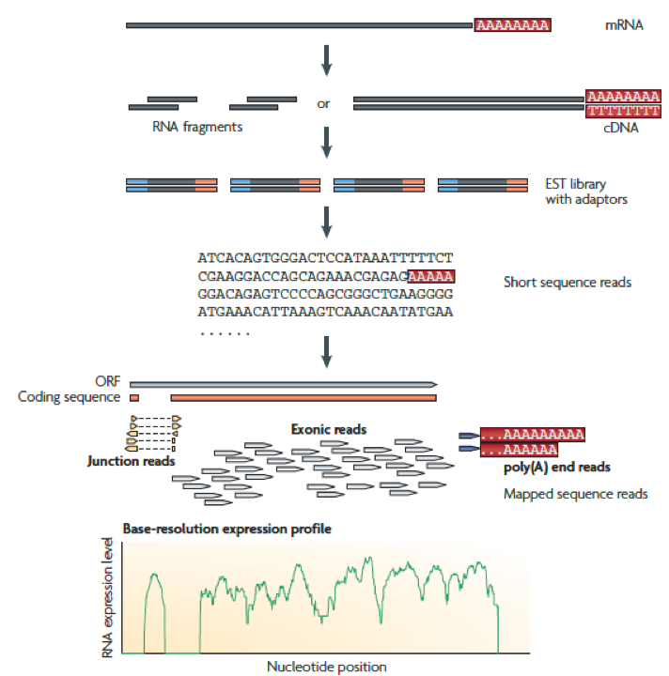
Biological Assays (contd.)
Genomic Assays:
Transcriptomics/RNA-Seq (Tissues):
Measures the amount of mRNA or total RNA
For mRNA, purify with poly-A signatures
Fragment, add adaptors, sequence, map to reference genome
Stack reads and quantify genes and/or transcripts
Nagalakshmi et al. 2009, Nat. Rev. Gen. 10, Pgs. 57-63

Slide 6
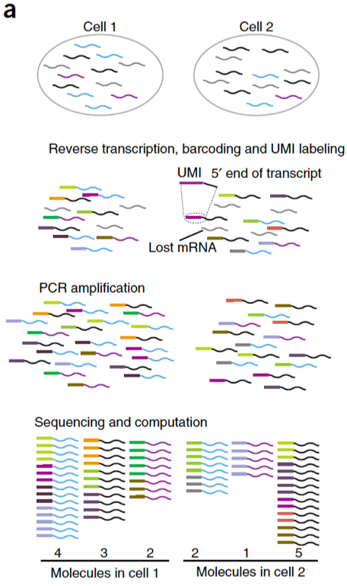
Biological Assays (contd.)
RNA-Seq (Single cells):
Measures the amount of mRNA in individual cells
For mRNA, purify with poly-A signatures
Fragment, add adaptors/barcodes, sequence, map to reference genome
Whole genome amplification
Stack reads and quantify genes
Islam et al. 2014, Nat. Methods 11(2), Pgs. 163-166

Slide 7
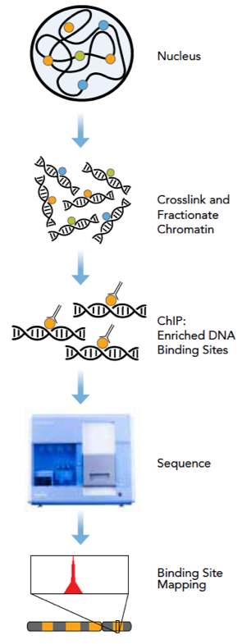
Biological Assays (contd.)
Chromatin Immunoprecipitation with sequencing (ChIP-seq):
Identifies regions of protein binding to DNA
Helps identify transcription factor-binding sites, histone mark locations, etc.
Use antibodies to pull down (“immunoprecipitated”) proteins along with bound DNA
DNA is processed in similar ways for sequencing and quantification
https://www.illumina.com/Documents/products/datasheets/datasheet_chip_sequence.pdf

Slide 8
Biological Assays (contd.)
Hi-C:
Study of the 3D structure of DNA in the nucleus (in situ)
Cross-link distal regions that are folded close to each other and sequence
DNase- and ATAC-seq:
Finds regions of transcriptionally active, “open” DNA
Proteomics and Metabolomics

Slide 9
Other data-types
Trait / Phenotype data:
Trait data can be continuous, categorical, univariate, multivariate …
Imaging data:
Histological, MRI (sMRI / fMRI) data types
Medical records:
Medical records can provide a rich source of trait data, and confounding factors (demographics, medical treatments…)

Slide 10
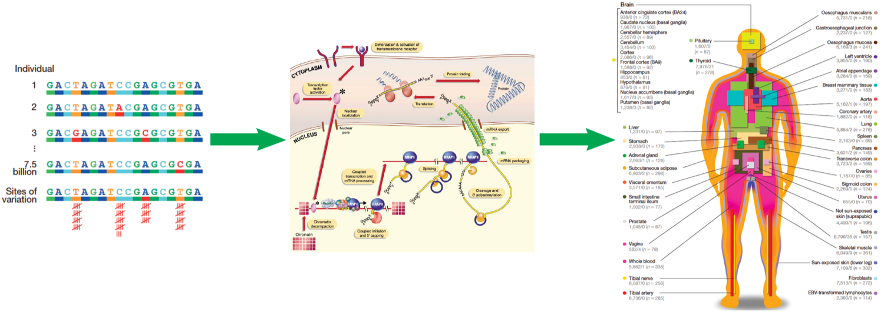
Genotype to Phenotype Hierarchy
Genetics
Genomics
Clinical
Image sources:
Orphanides and Reinberg 2002, Cell 108, P. 439-451
Shendure et al. 2017, Nat. Rev. 550, P. 345-353
GTEx Consortium 2017, Nature 550, P. 204-213

Slide 11
RNA-Seq for gene expression quantification
Library preparation
Sequencing
Raw Read QC
Mapping to genome
Mapped Read QC
Peak calling and Gene/Transcript Counting

Slide 12
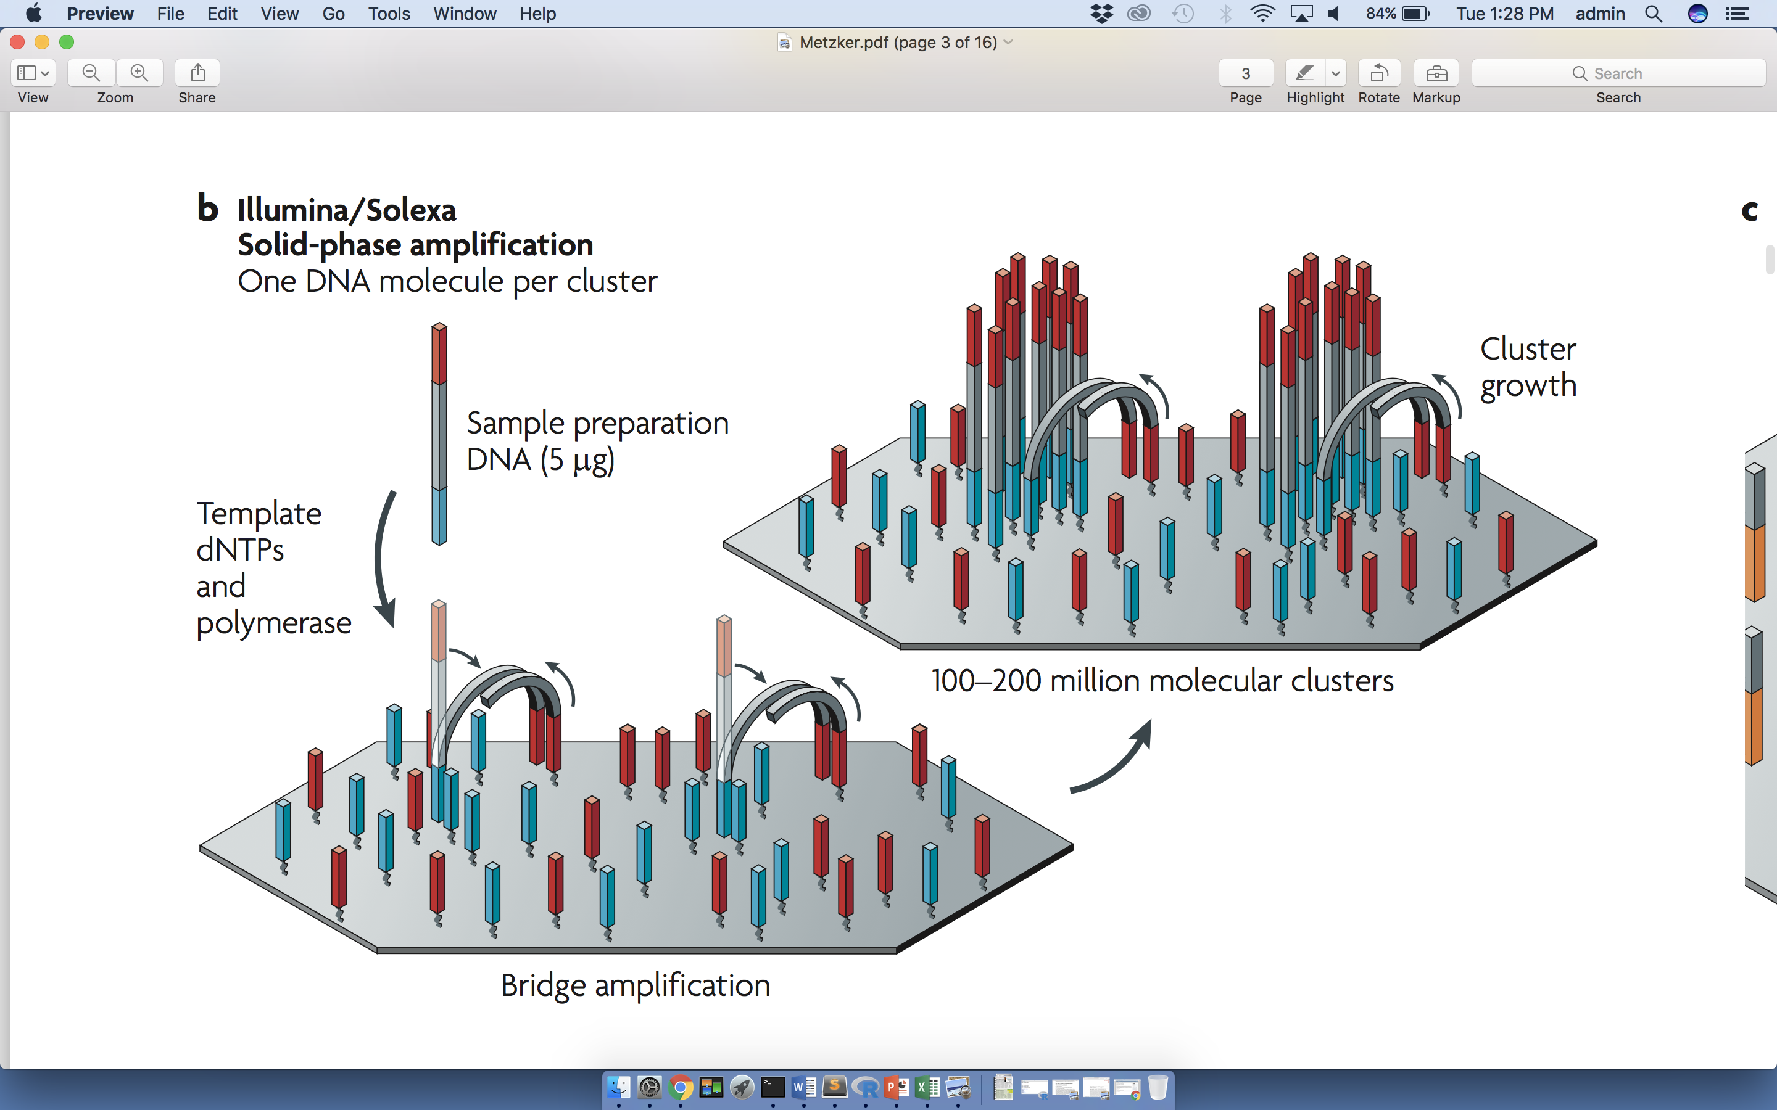
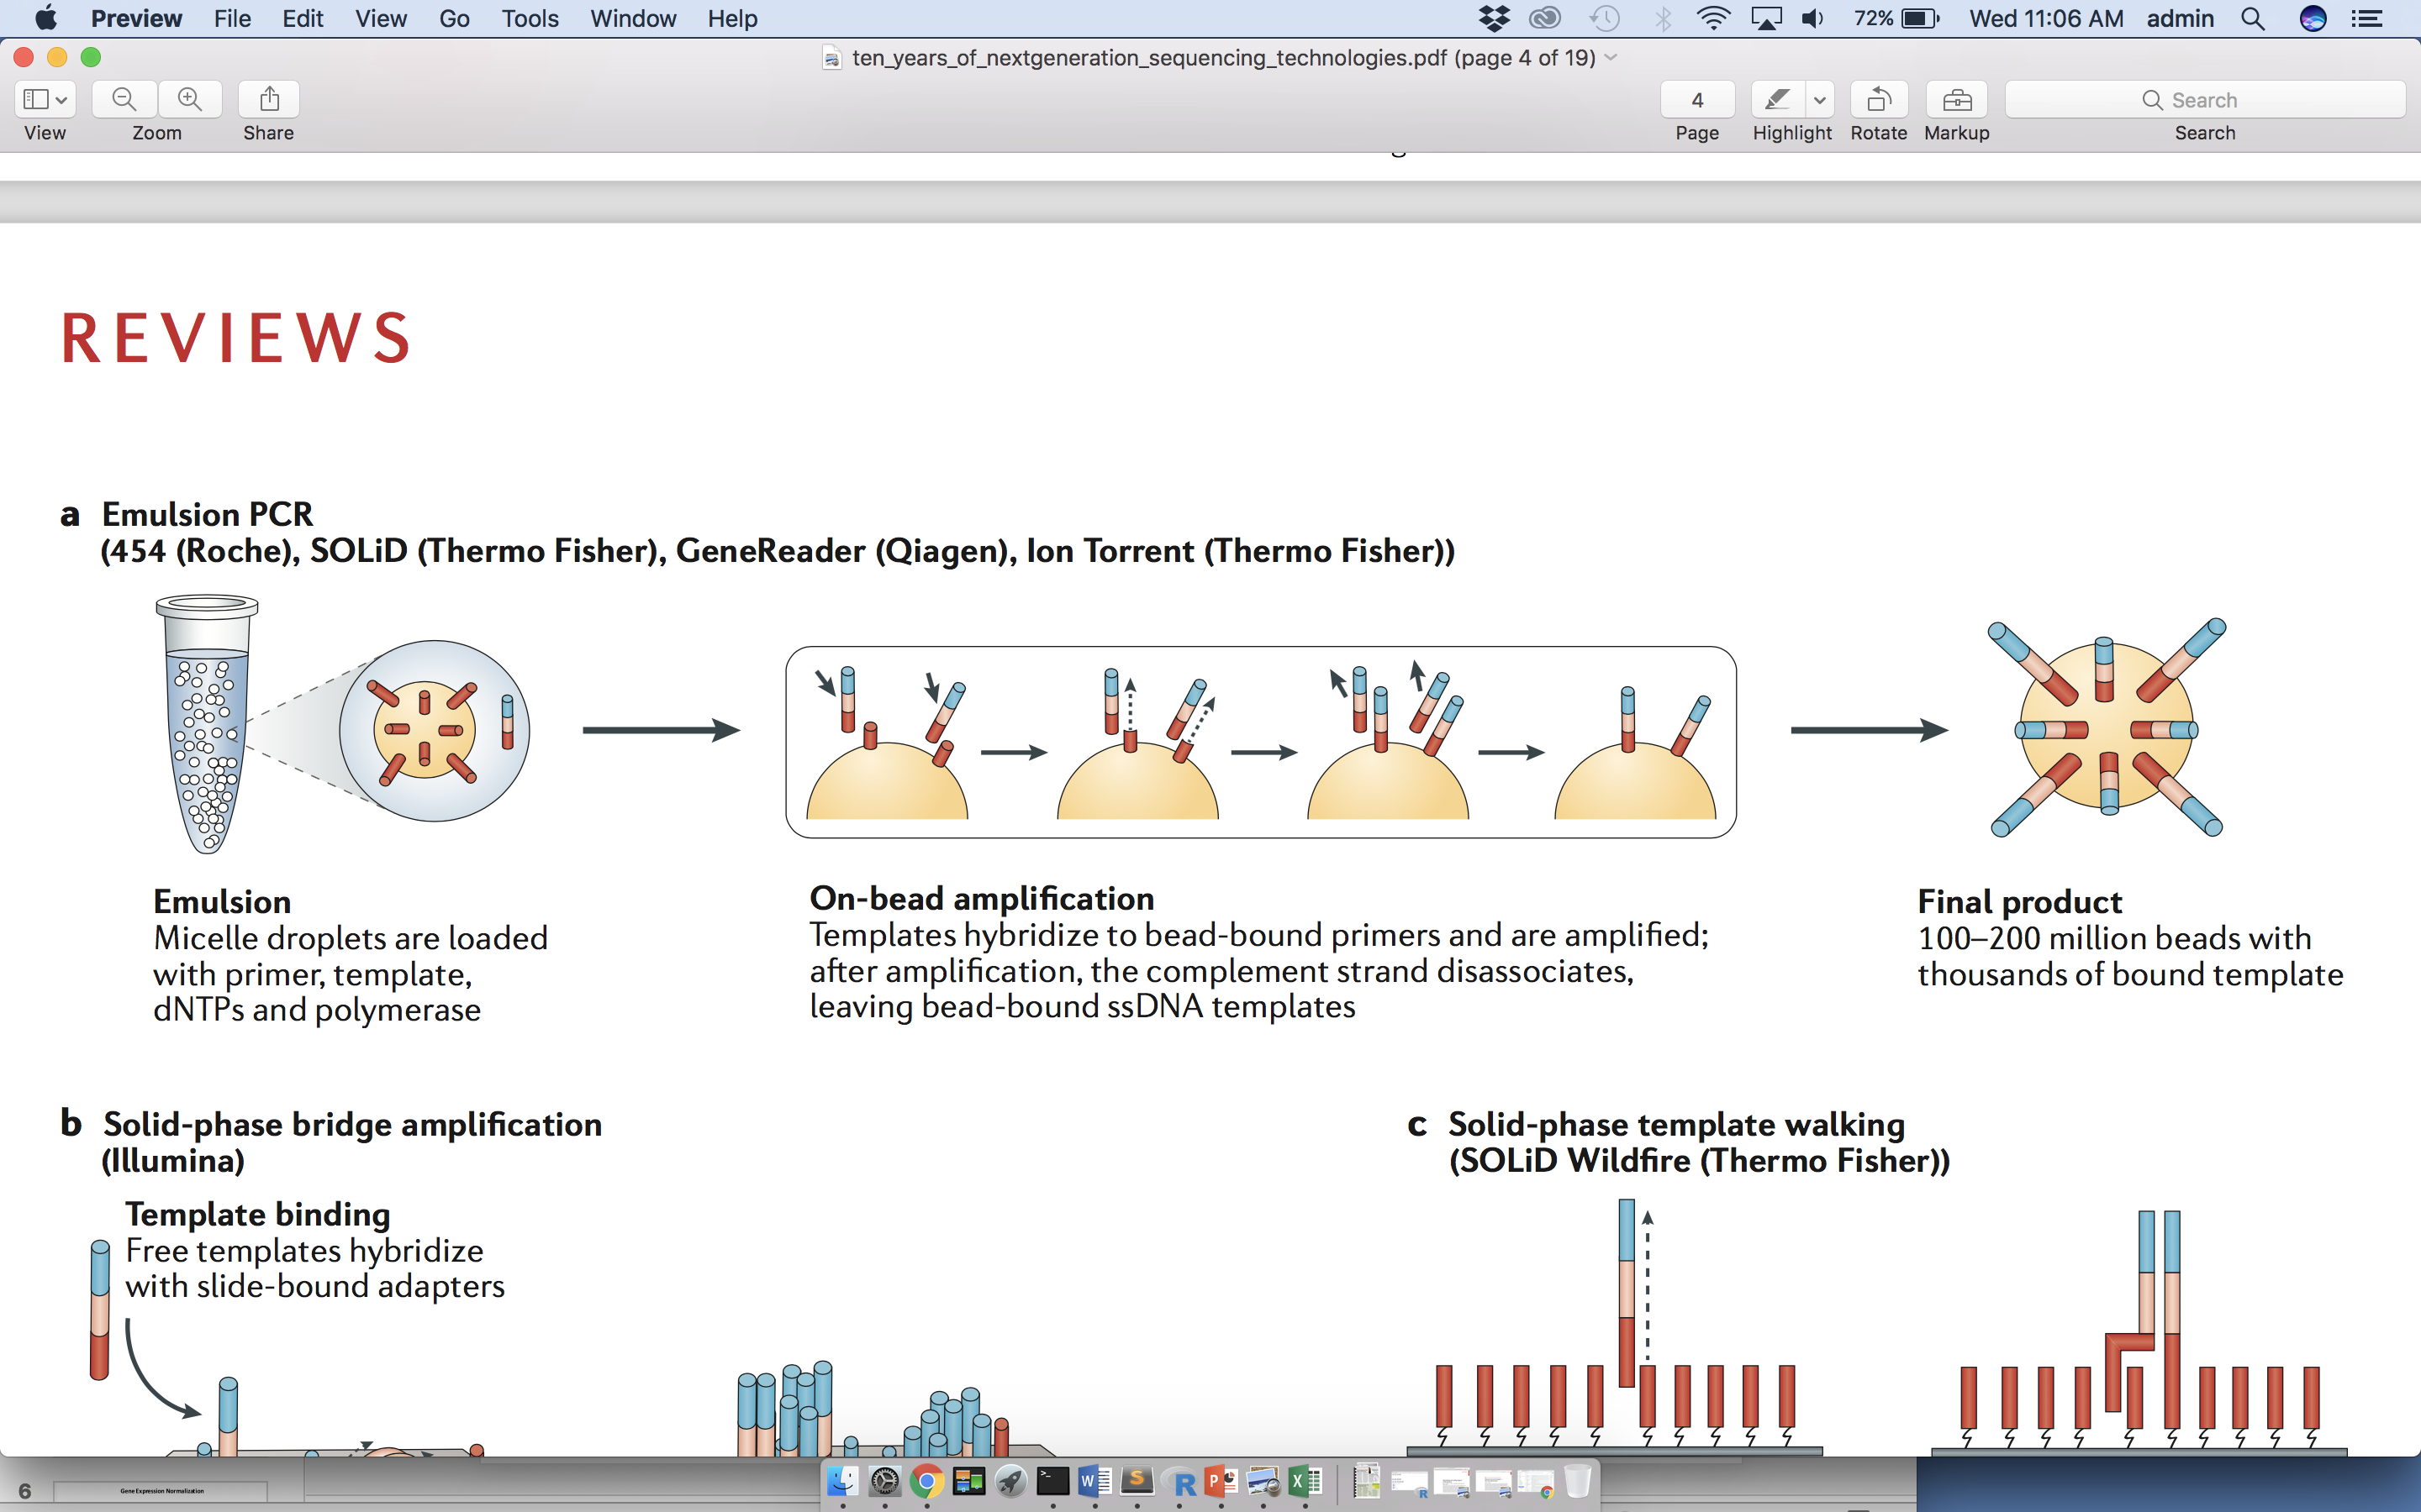
Next-generation sequencing
Examples of amplification strategies
Metzker, NRG (2010)
Goodwin, NRG (2016)

Slide 13
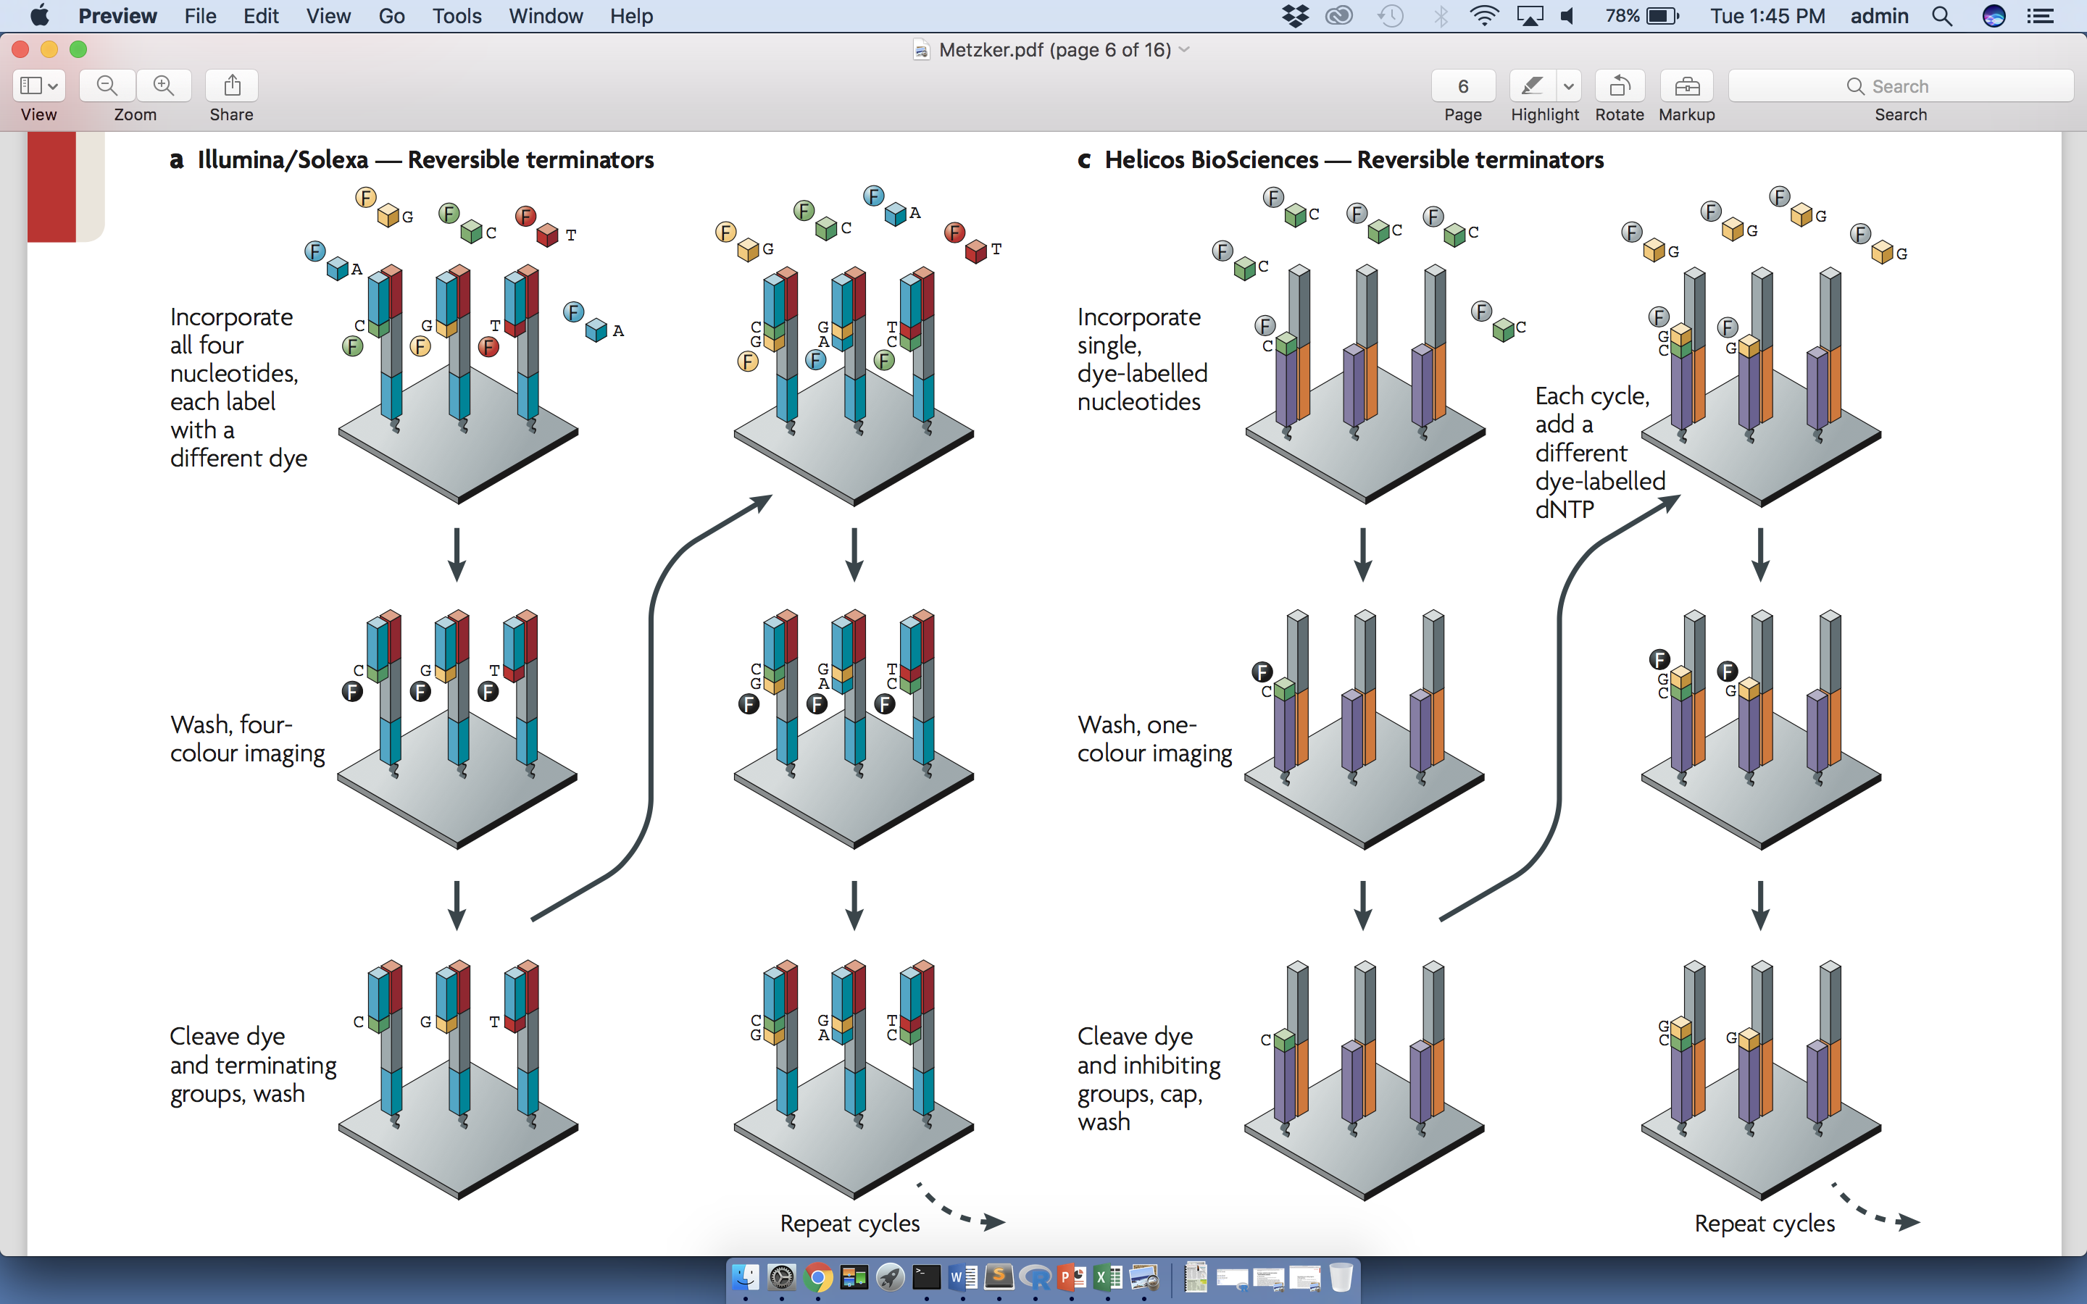
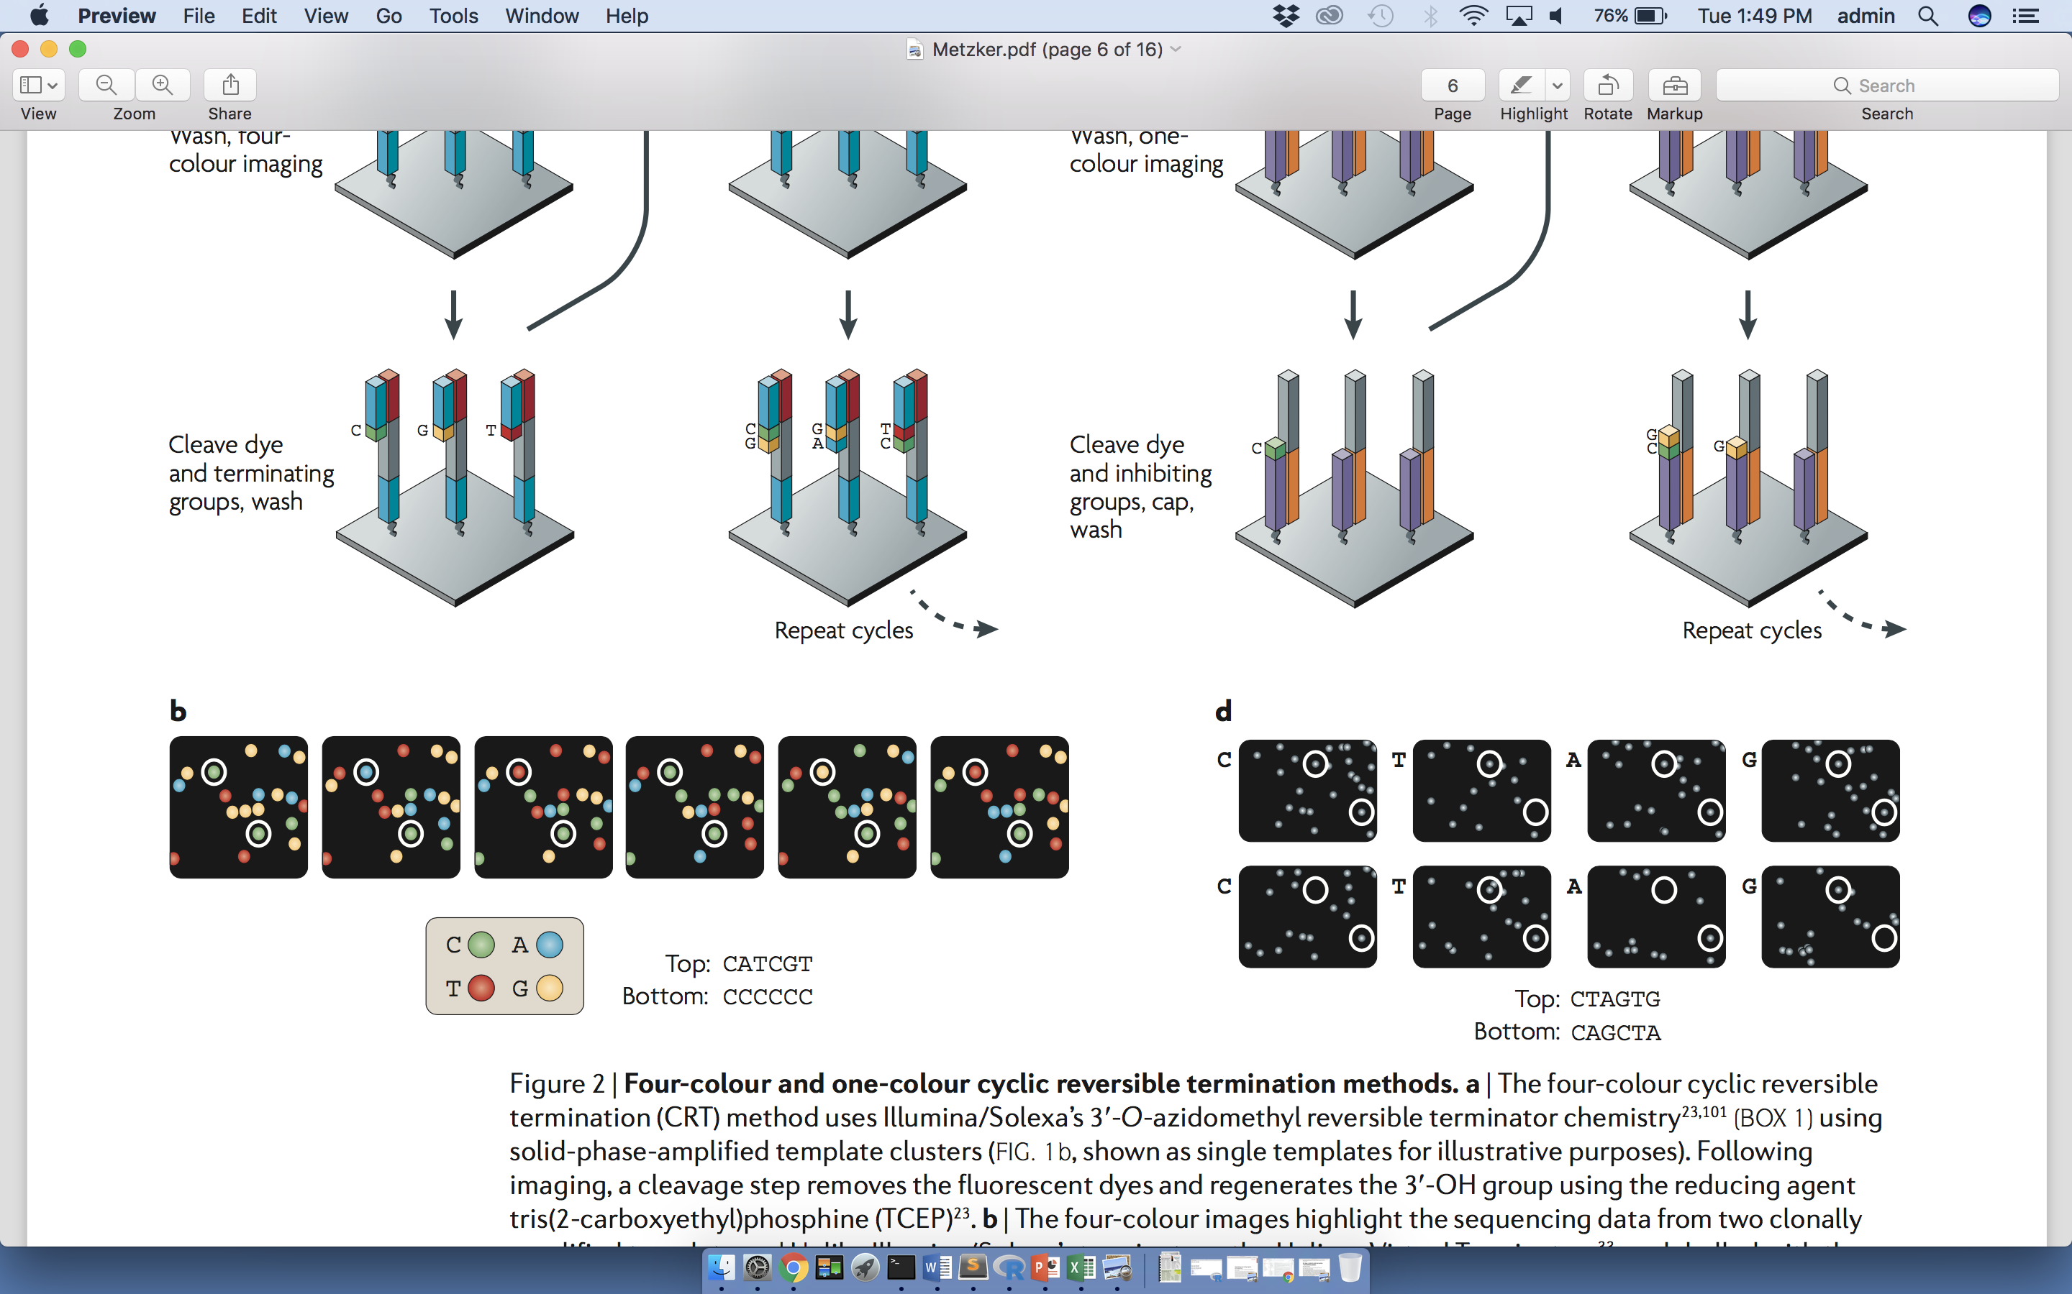
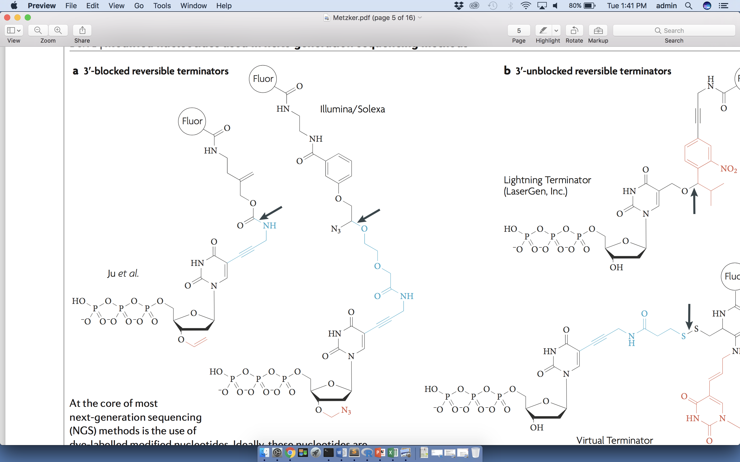
Next-generation sequencing
Reversible terminators and fluorescence detection
Left:
CCCCCC
Right:
CATCGT
Metzker, NRG (2010)

Slide 14
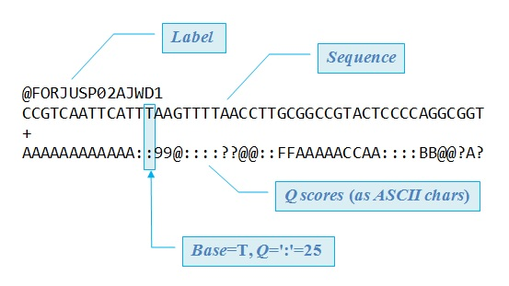
Raw Output from Sequencing: FASTQ Files
Base sequences and associated scores in ASCII format
Common fastq software:
FastQC (http://www.bioinformatics.babraham.ac.uk/projects/fastqc/)
Cutadapt (https://doi.org/10.14806/ej.17.1.200)
Robert Edgar, drive5.com

Slide 15
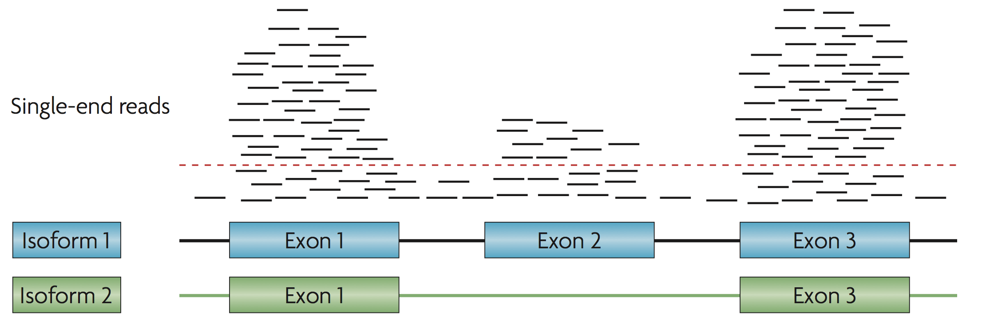
Mapping/Alignment
Map reads (from FASTQ files) to human reference genome. Alignment can be performed using a number of available software suites. The output is ultimately provided as BAM file.
Commonly used aligners:
BWA-MEM (Li H. and Durbin R. (2009) Bioinformatics, 25:1754-60)
STAR aligner (Dobin et al (2013) Bioinformatics, 29(1):15–21)
Alexander et al, NRG (2010)

Slide 16
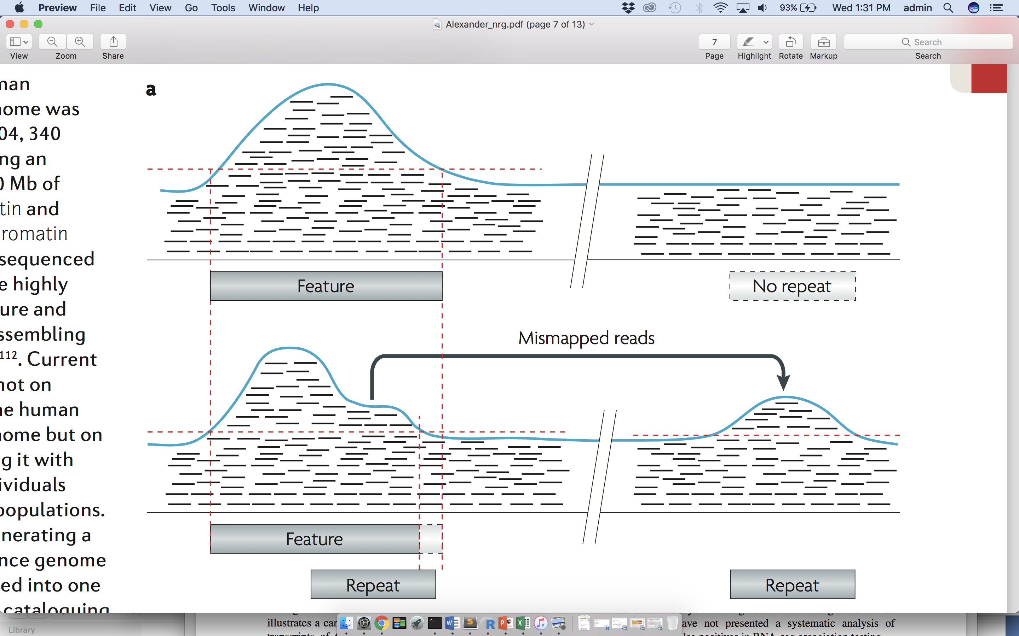
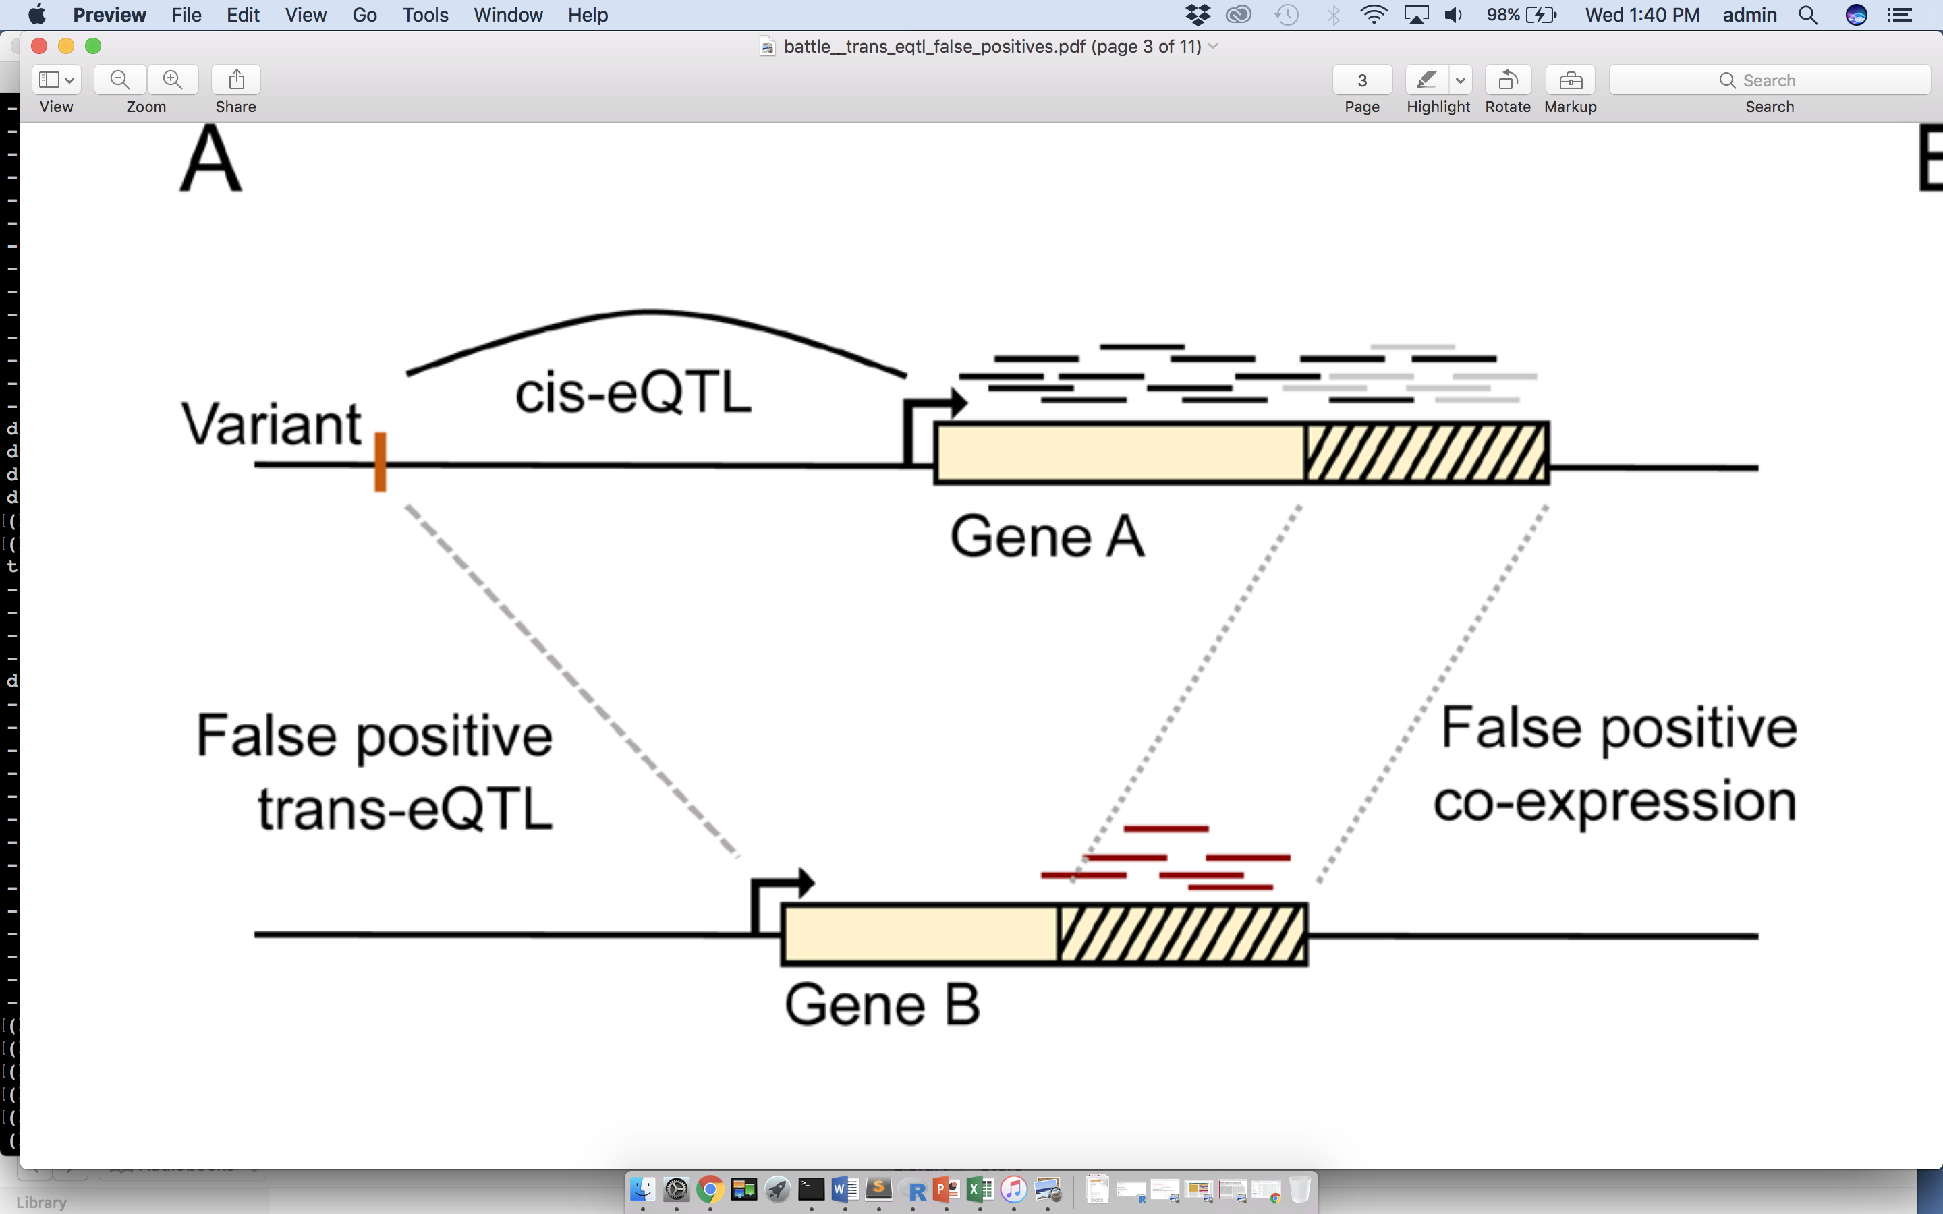
Mapped Read Quality Control
Experimental error may result in poor expression quantification. Many of the reads must be discarded entirely, and there may be a number of reasons for doing so:
+ failed to align well
+ failed to align at all (i.e., unmapped reads)
+ opposite problem: multi-mapping
+ duplicates
Saha et al, 2018
R Alexander, 2010

Slide 17
Peak Calling and Quantification
Once high-quality reads are aligned with confidence, how much is each gene expressed within a given tissue? As with quality control, a number of software tools may be used for peak calling and quantification (one example is MACS2).
A number of metrics are used in order to report expression levels:
one popular choice is reads per kilobase of transcript, per Million mapped reads (RPKM -- needed in order to control for entire read count for a sample)
Another approach is to use Transcripts Per Kilobase Million (TPM): first normalize for annotation length, and THEN normalize for sequencing depth

Slide 18
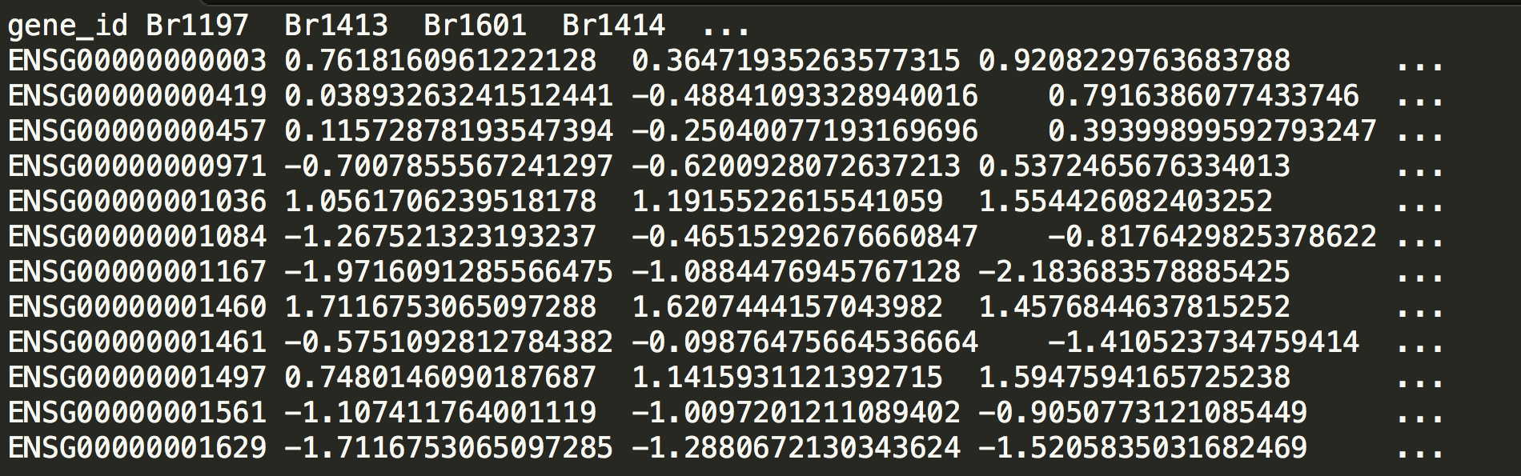
Output
A sample from a gene expression matrix

Slide 19
Resources
Software tools:
Read mapping: STAR, BLAST, RSEM
Genetics / general: PLINK, HAIL, SAMtools
eQTL analysis: Fast-QTL, QTL-tools
GWAS/polygenic scores: GCTA, LDSR
Sources of data:
Genetics: 1000 Genomes, Hapmap
Genomics: ENCODE, ENCODEC, EnTEX, PsychENCODE,
GTEx, Epigenomics Roadmap
Large-scale collections: UKbiobank, TCGA (cancer), PGC (psychiatric)

Slide 20
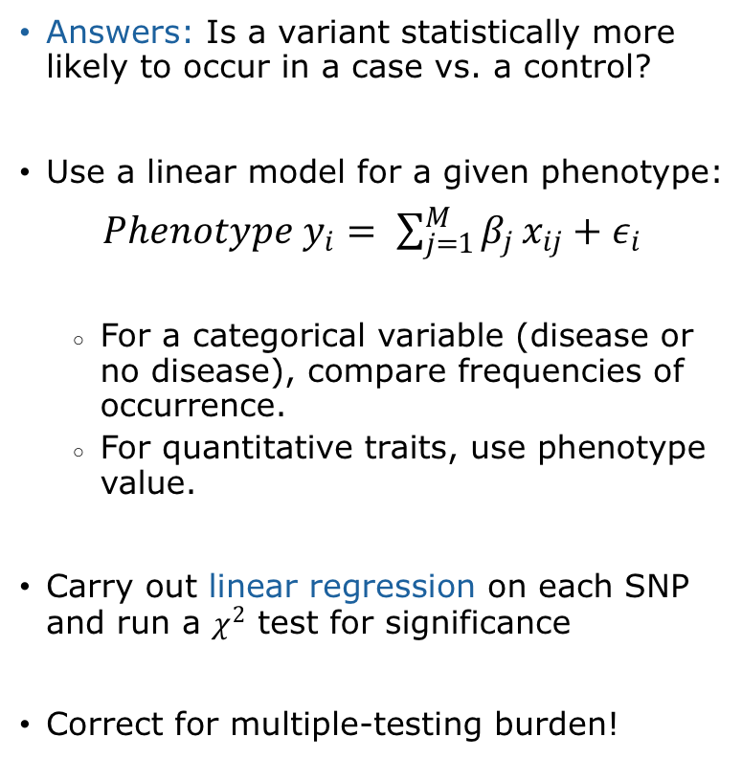
Machine Learning Applications: Genome-Wide Association Studies (GWAS)
Answers: Is a variant statistically more likely to occur in a case vs. a control?
Use a linear model for a given phenotype:
$Phenotype y_{i}= \sum_{j=1}^{M}{β_{j}}x_{ij}+ε_{i}$
For a categorical variable (disease or no disease), compare frequencies of occurrence.
For quantitative traits, use phenotype value.
Carry out linear regression on each SNP and run a $χ^{2}$ test for significance
Correct for multiple-testing burden!
Klein et al 2002, Science, 308, P. 385-389

Slide 21
Machine Learning Applications: Genome-Wide Association Studies (GWAS) (contd.)
SCZ Working Group of the PGC 2014, Nature, 511, P. 421-427

Slide 22
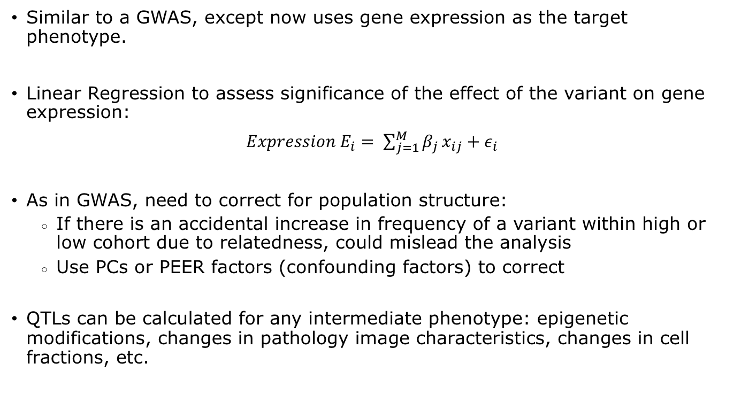
Machine Learning Applications: Expression Quantitative Trait Loci (eQTL)
Similar to a GWAS, except now uses gene expression as the target phenotype.
Linear Regression to assess significance of the effect of the variant on gene expression:
$Expression E_{i}= \sum_{j=1}^{M}{β_{j}}x_{ij}+ε_{i}$
As in GWAS, need to correct for population structure:
If there is an accidental increase in frequency of a variant within high or low cohort due to relatedness, could mislead the analysis
Use PCs or PEER factors (confounding factors) to correct
QTLs can be calculated for any intermediate phenotype: epigenetic modifications, changes in pathology image characteristics, changes in cell fractions, etc.

Slide 23
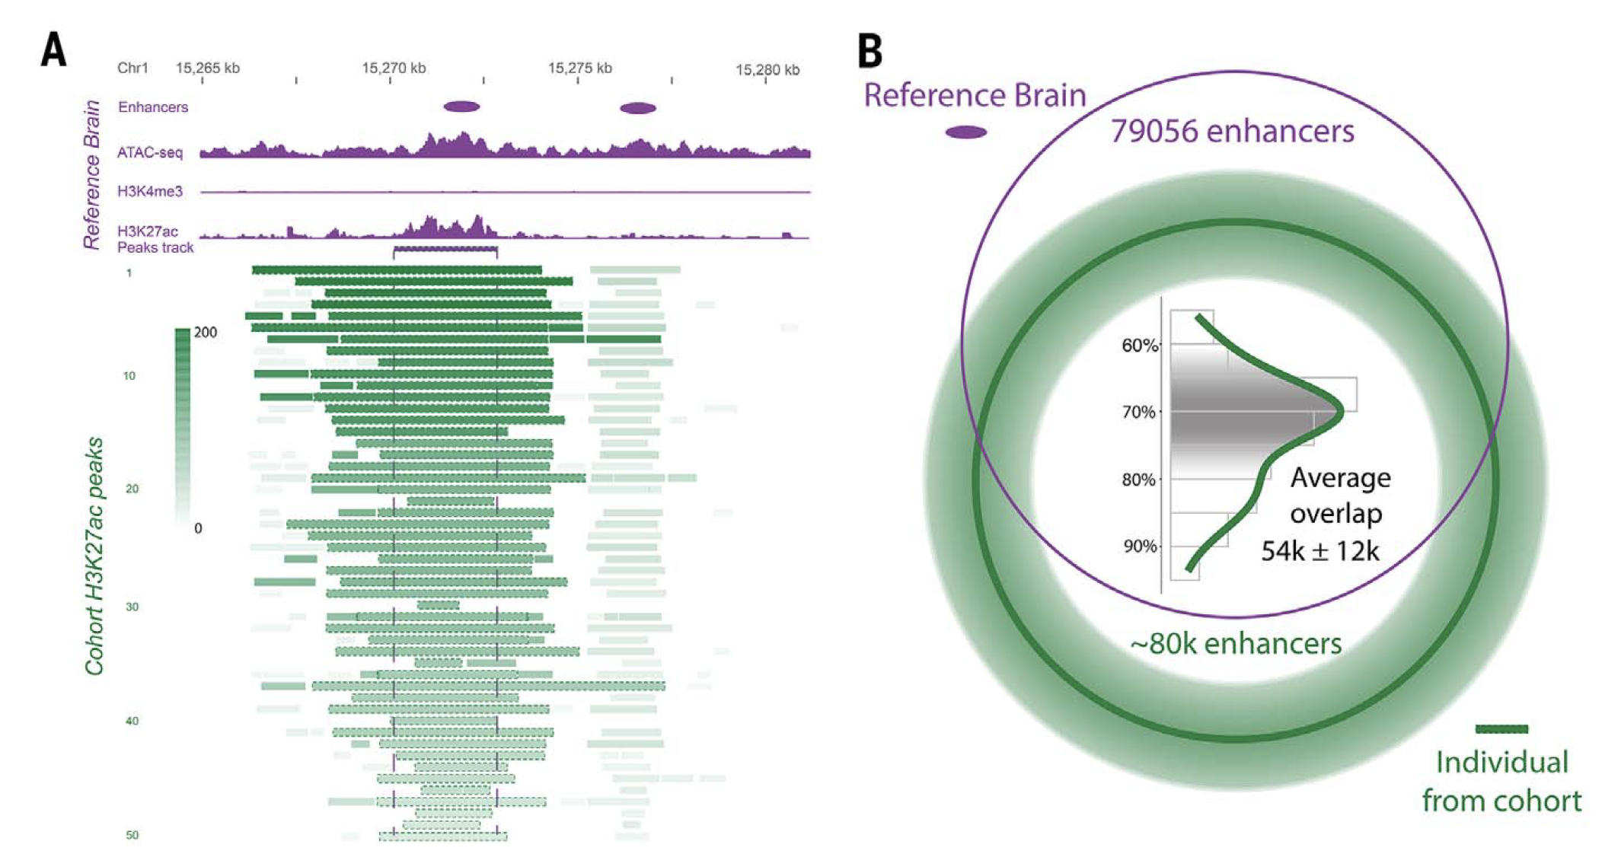
Machine Learning Applications: Enhancer identification

Slide 24
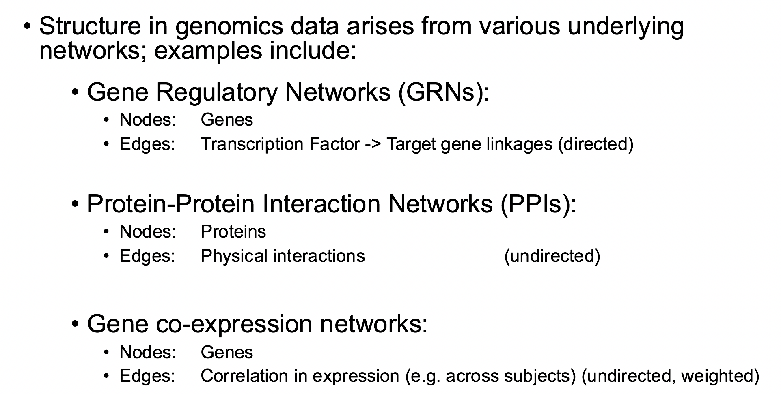
Machine Learning Applications: Biological Networks

Slide 25
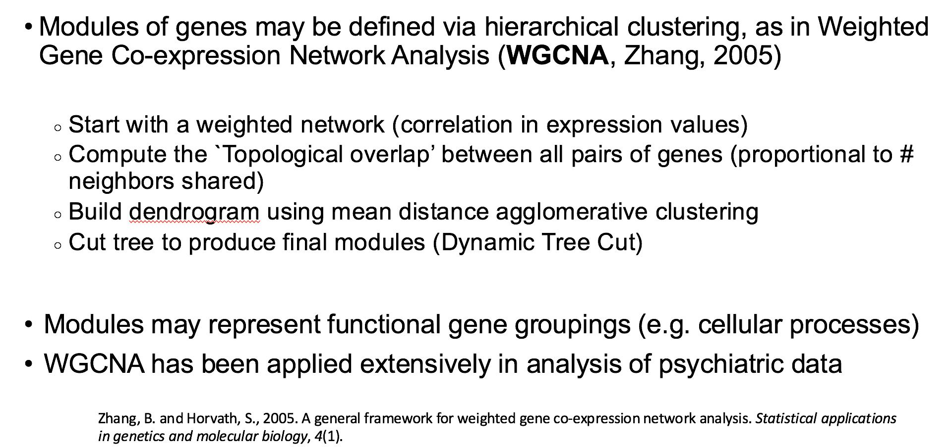
Machine Learning Applications: Weighted Gene Co-expression Network Analysis

Slide 26
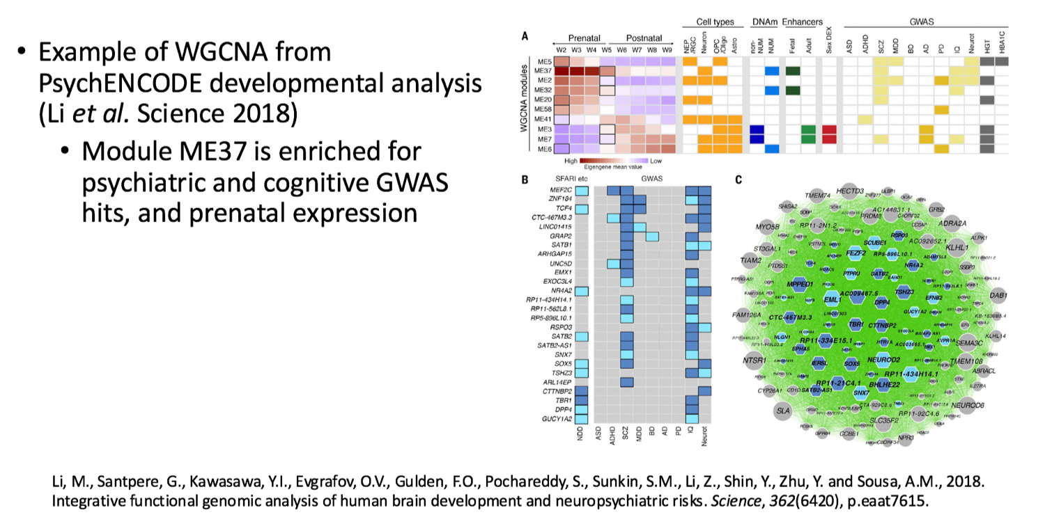
Machine Learning Applications: Weighted Gene Co-expression Network Analysis

Slide 27
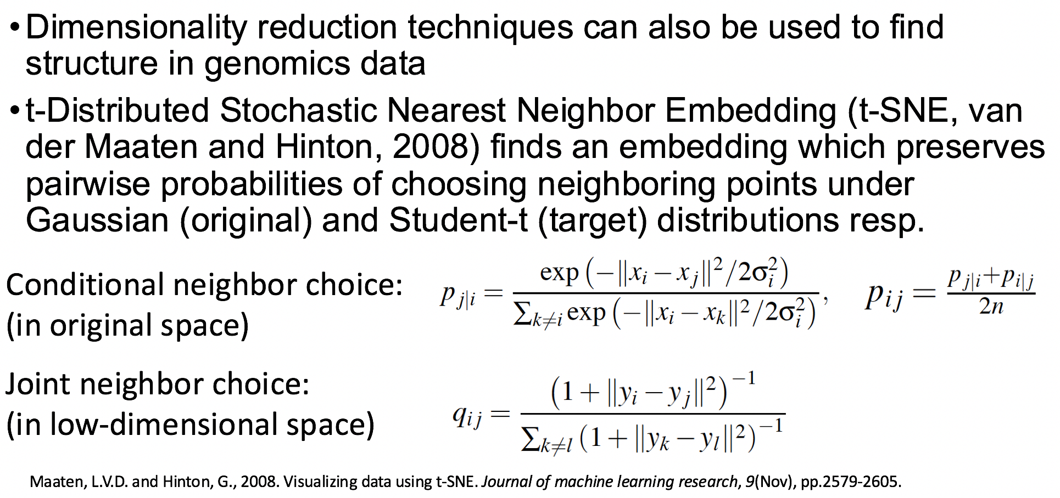
Machine Learning Applications: Dimensionality reduction: t-SNE

Slide 28
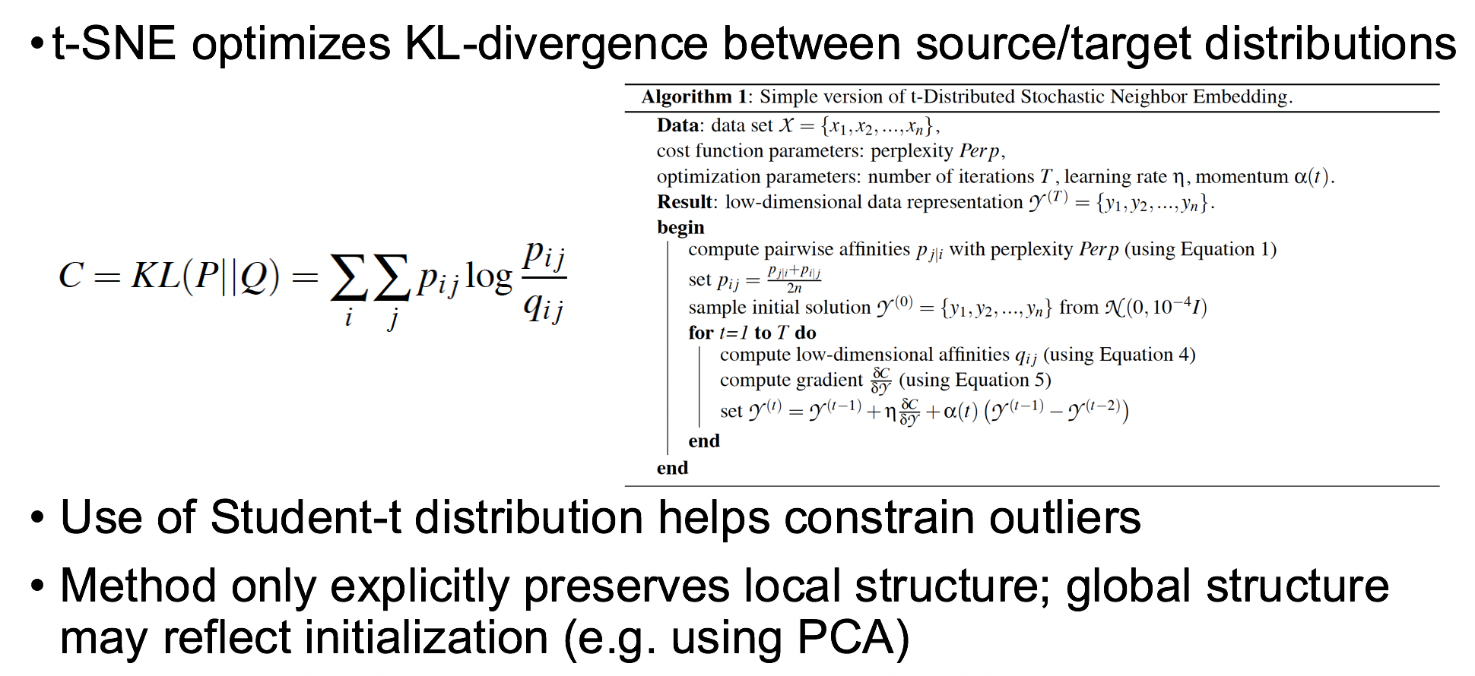
Machine Learning Applications: Dimensionality reduction: t-SNE

Slide 29
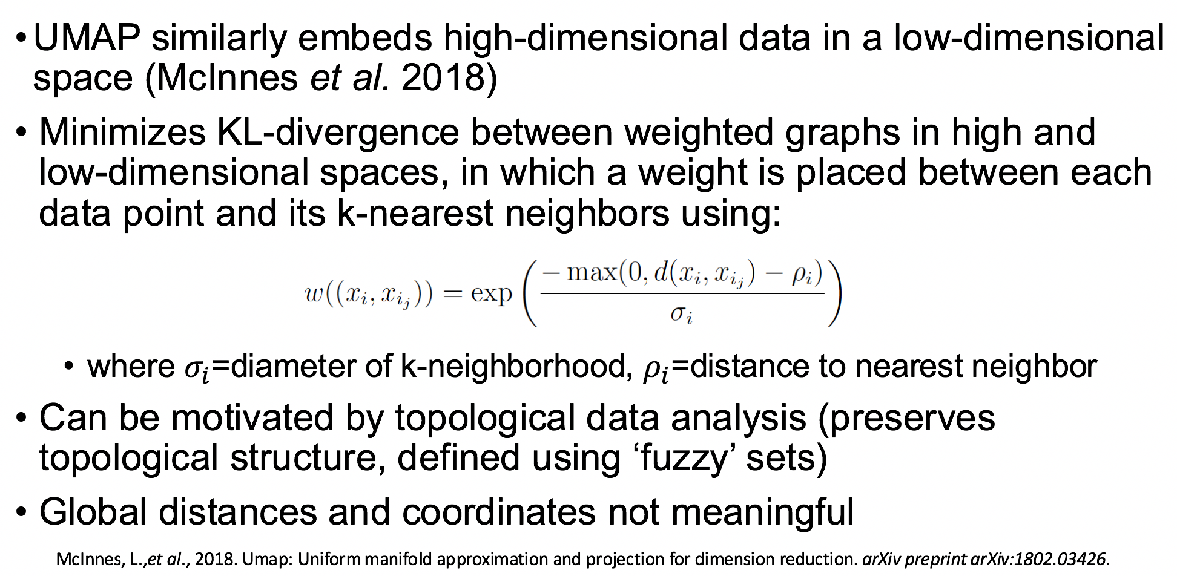
Machine Learning Applications: Dimensionality reduction: UMAP

Slide 30
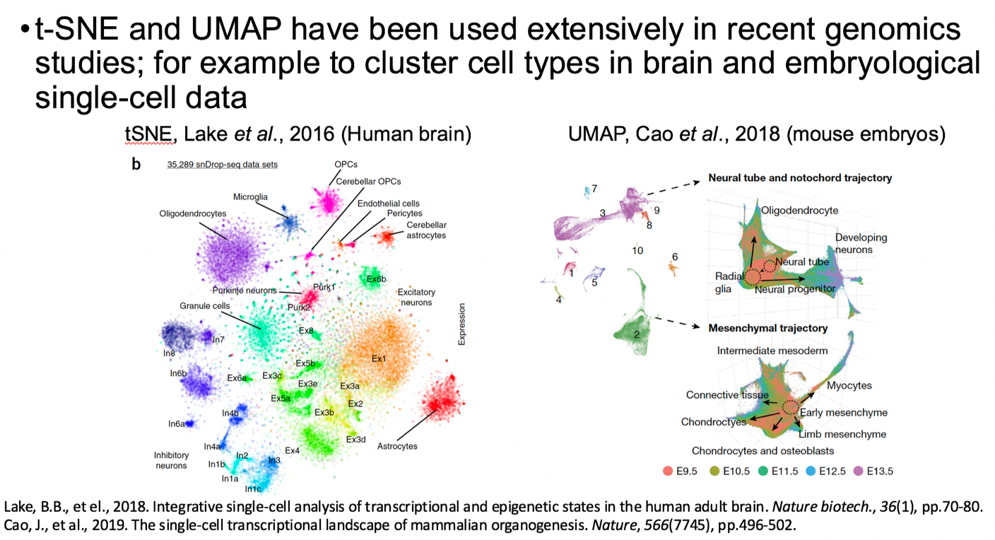
Machine Learning Applications: Dimensionality reduction: t-SNE/UMAP

Slide 31
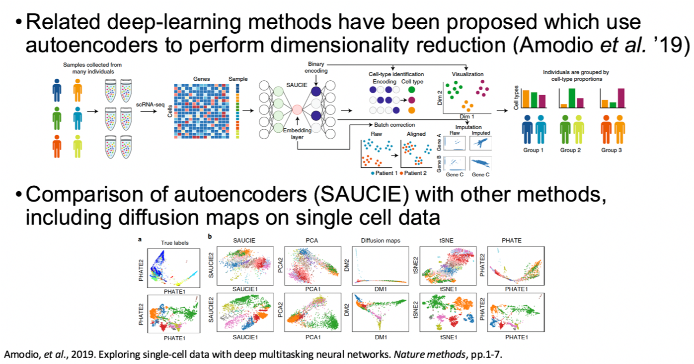
Machine Learning Applications: Dimensionality reduction: Deep learning

Slide 32
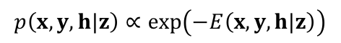
Machine Learning Applications: Deep Structured Phenotype Network (DSPN)
Boltzmann machine
y: phenotypes
h: hidden units (e.g., circuits)
x: intermediate phenotypes (e.g., genes, enhancers)
z: genotypes (e.g., SNPs)
W: weights (e.g., regulatory network)
Gene regulatory network
builds
skeleton
Energy model:
$$p\left(x,y,h|z\right)∝\exp\left(−E\left(x,y, h|z\right)\right)$$
$$E\left(x,y, h|z\right)={−z}^{T}W_{1}x{−x}^{T}W_{2}x−x^{T}W_{3}h−h^{T}W_{4}h−h^{T}W_{5}y−Bias$$
[Wang et al. (‘18) Science]

Slide 33
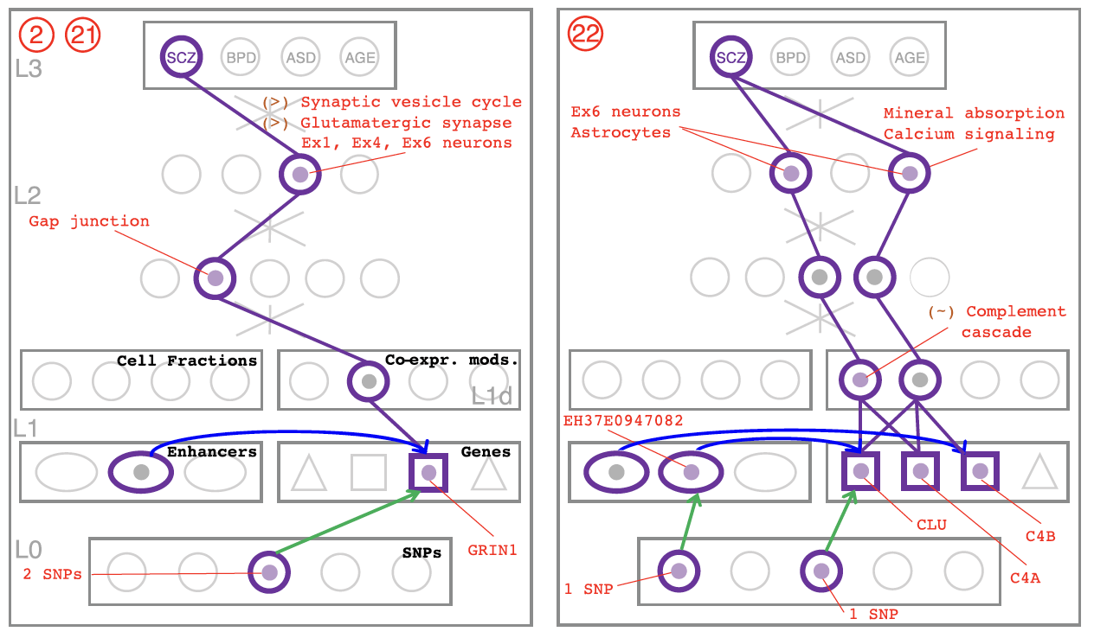
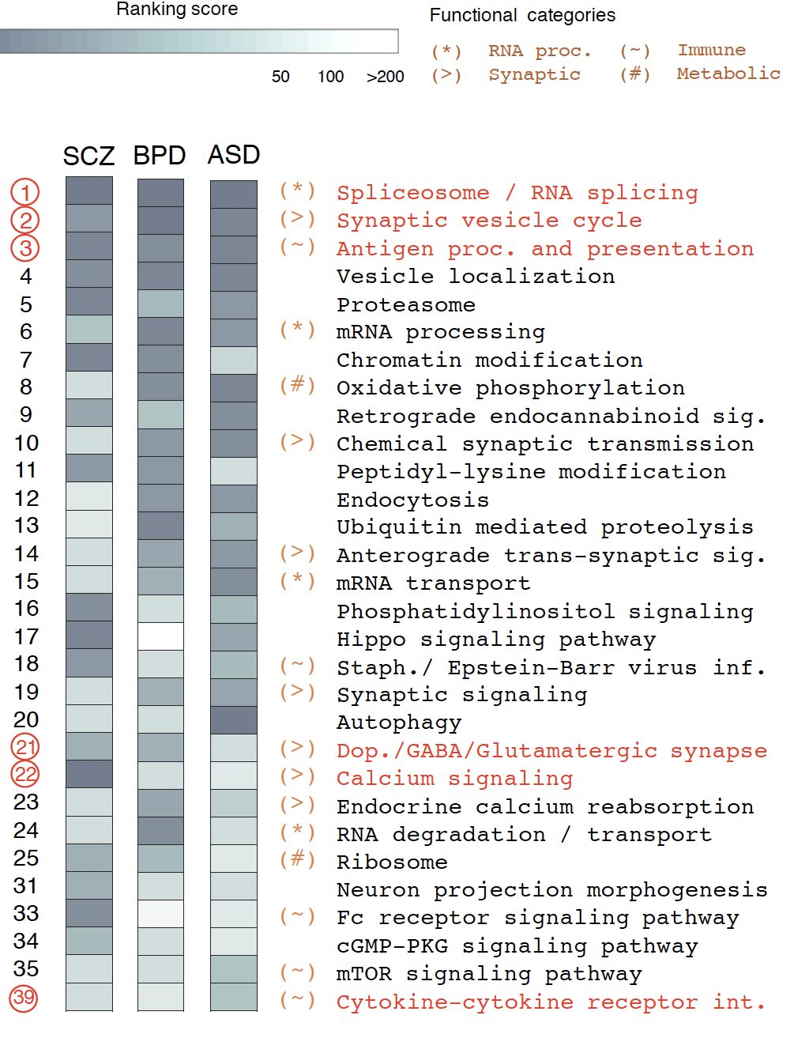
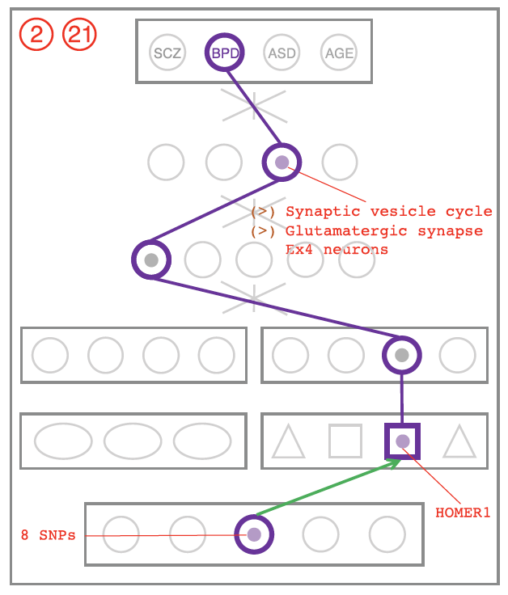
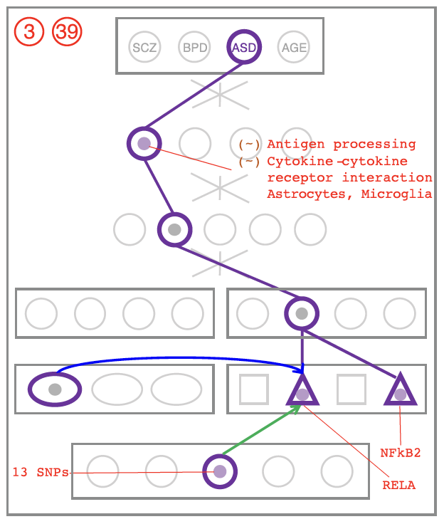
Machine Learning Applications: DSPN discovers enriched pathways and linkages to genetic variation
Cross-disorder MOD/HOG enrichment ranking
SCZ
BPD
ASD
[Wang et al. (‘18) Science]

Slide 34
References
Bioinformatics references:
GTEx Consortium. "Genetic effects on gene expression across human tissues." Nature 550, no. 7675 (2017): 204.
Wang, D., Liu, S., Warrell, J., Won, H., Shi, X., Navarro, F.C., Clarke, D., Gu, M., Emani, P., Yang, Y.T. and Xu, M., 2018. Comprehensive functional genomic resource and integrative model for the human brain. Science, 362(6420).
Bycroft, Clare, Colin Freeman, Desislava Petkova, Gavin Band, Lloyd T. Elliott, Kevin Sharp, Allan Motyer et al. "The UK Biobank resource with deep phenotyping and genomic data." Nature 562, no. 7726 (2018): 203.
Alon, Uri. An introduction to systems biology: design principles of biological circuits. Chapman and Hall/CRC, 2006.

Slide 35
References (contd.)
Nagalakshmi et al. 2009, “RNA-Seq: a revolutionary tool for transcriptomics” Nat. Rev. Gen. 10, Pgs. 57-63
Islam et al. 2014, “Quantitative single-cell RNA-seq with unique molecular identifiers” Nat. Methods 11(2), Pgs. 163-166
Shendure et al. 2017, “DNA sequencing at 40: past, present and future” Nat. Rev. 550, Pgs. 345-353
Alexander, Roger P., et al. "Annotating non-coding regions of the genome." Nature Reviews Genetics 11.8 (2010): 559.
Goodwin, Sara, John D. McPherson, and W. Richard McCombie. "Coming of age: ten years of next-generation sequencing technologies." Nature Reviews Genetics 17.6 (2016): 333.
Metzker, Michael L. "Sequencing technologies—the next generation." Nature reviews genetics 11.1 (2010): 31.
Robert Edgar, drive5.com (credit attribution information not provided: image taken from: https://www.drive5.com/usearch/manual/fastq_files.html)
Saha, Ashis, and Alexis Battle. "False positives in trans-eQTL and co-expression analyses arising from RNA-sequencing alignment errors." F1000Research 7 (2018).

